Slide 1
Getting Started with GridLAB-D on the Cloud
David P. Chassin (SLAC)
CEC Advanced Simulation Program
5 September 2019
This presentation was prepared with funding from the California Energy Commission under grant EPC-17-046. SLAC National Accelerator Laboratory is operated for the US Department of Energy by Stanford University under Contract No. DE-AC02-76SF00515

Slide 2
Why run GridLAB-D on cloud platforms?
Multiple GridLAB-D version extant, e.g.,
4.0 stable from PNNL
4.1 dev from PNNL
4.2 dev from SLAC
Building and maintaining GridLAB-D on local system is very challenging
Cloud platforms offer infrastructure to manage version easily
Repeatability is high using public/standard GridLAB-D images
Strong security with project/model/data sharing infrastructure
Scalable compute resources and benefits from recent experience of others

Slide 3
Cloud resources
Three major cloud services platform providers
Amazon Web Services (AWS)
Microsoft Azure
Google Cloud (GCP)
Cloud services integration providers
CircleCI
Travis CI
Many others (see https://www.g2.com/categories/continuous-integration)

Slide 4
Requirements: GridLAB-D simulation workflow
External
datasets
Import & Validate (OpenFIDO)
CSV Files
External models
Simulate
(HiPAS & GLOW)
Analyse (custom)
Plots
Shared datasets
Copy/link
(Cloud Security)
MySQL Data
Shared models

Slide 5
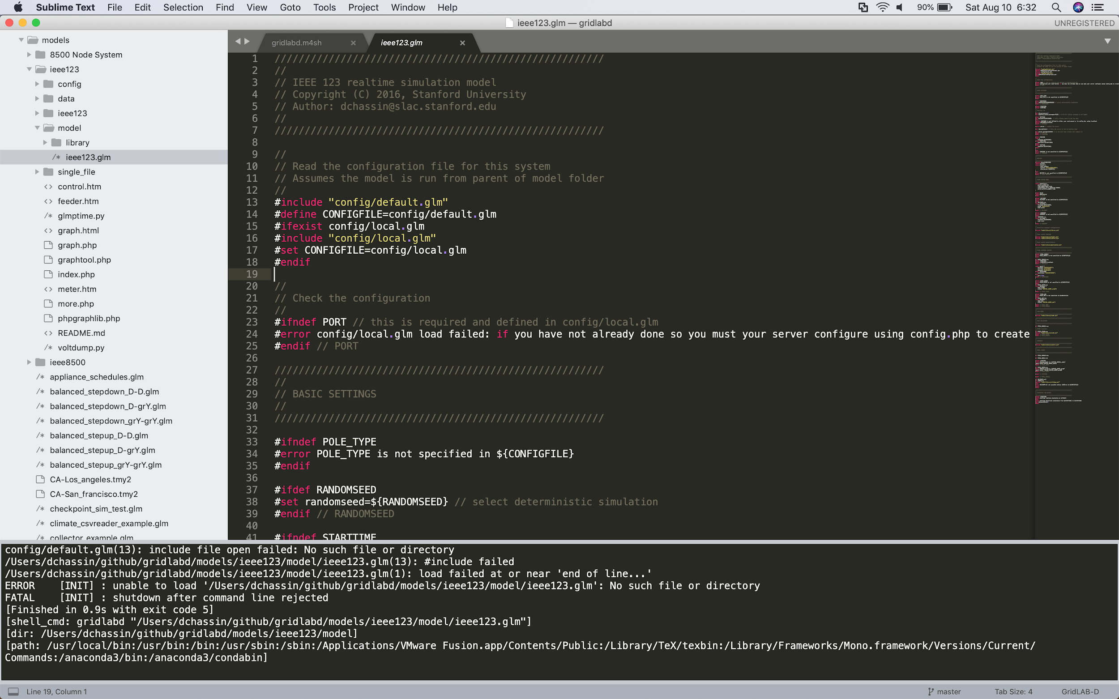
GridLAB-D CI-based workflow
GitHub
circleci
model
3
1
template
4
edits
results
2

Slide 6
Quick Guide to Using CircleCI with GitHub
Create a GitHub account at github.com
Import the gridlabd-ci-test project
Link your GitHub account at circleci.com
Follow your gridlabd-ci-test project on CircleCI
Download the results from the CircleCI artifacts

Slide 7
Create Your GridLAB-D Model

Slide 8
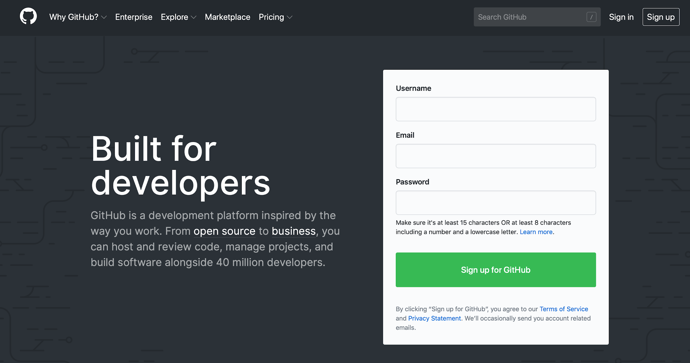
Creating your GitHub account
1
2
3
4

Slide 9
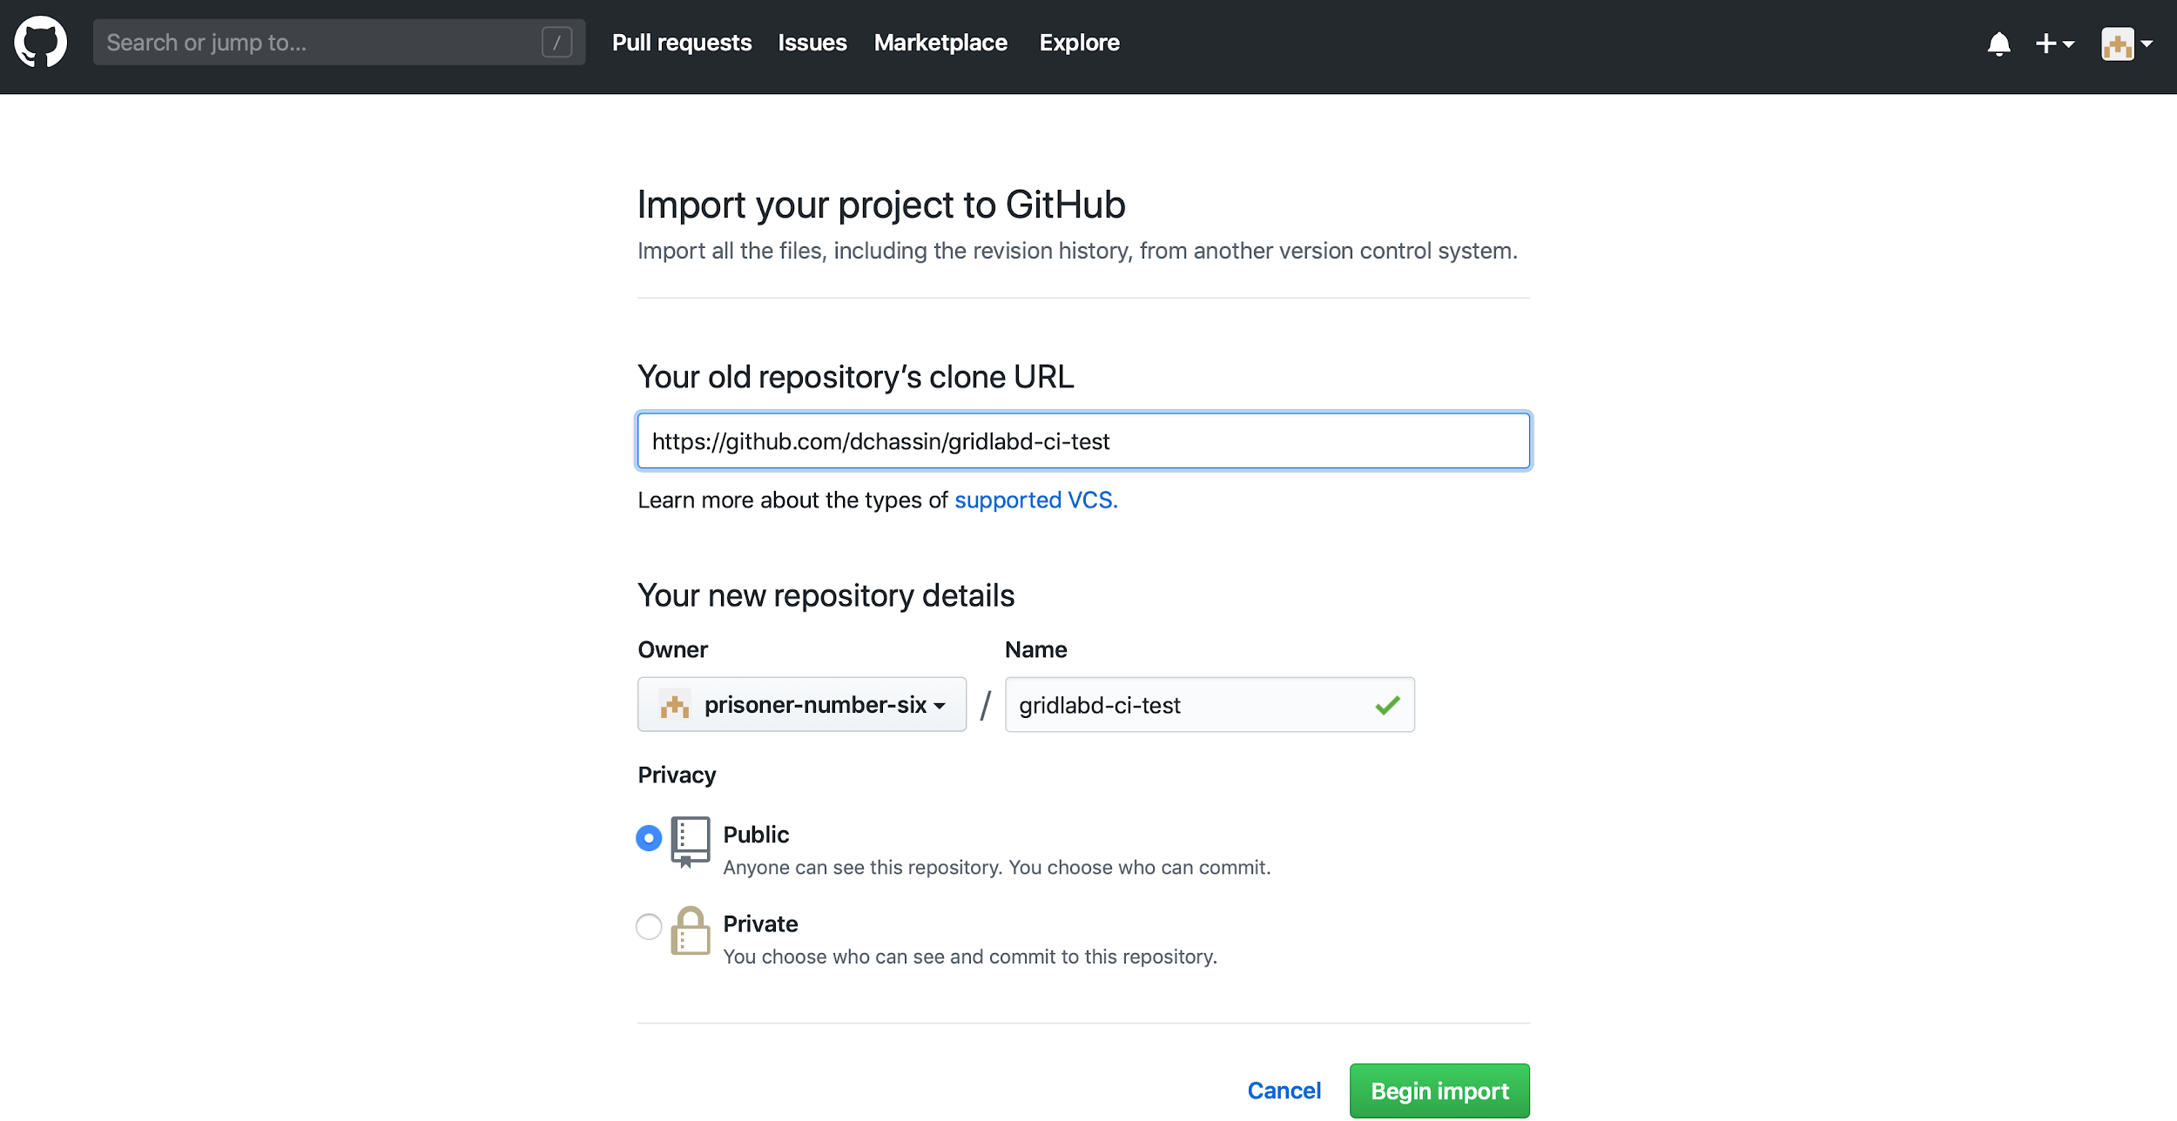
Import the GridLAB-D CircleCI test repository
1
2
3

Slide 10
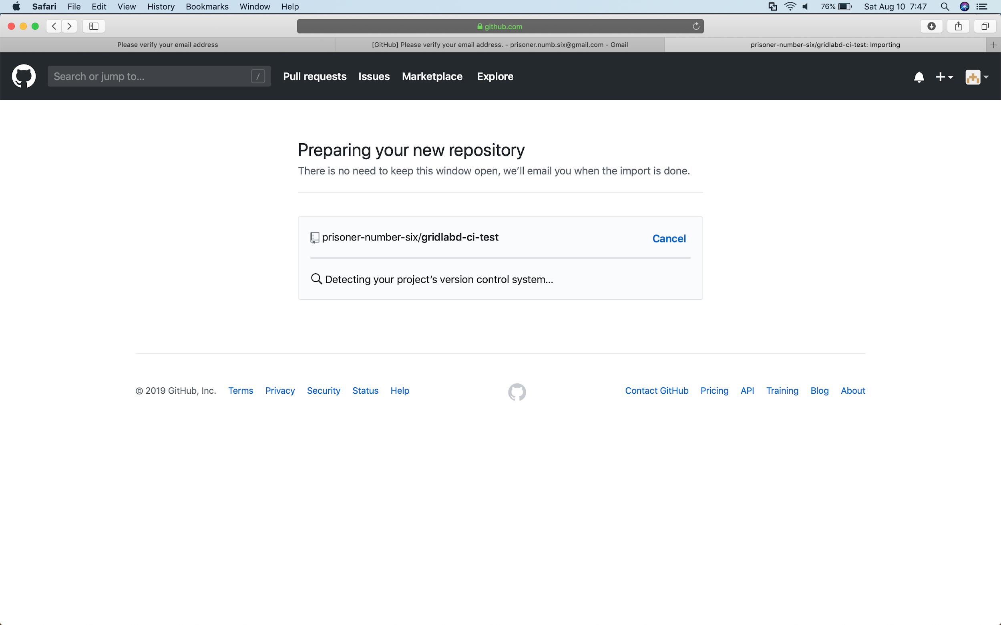
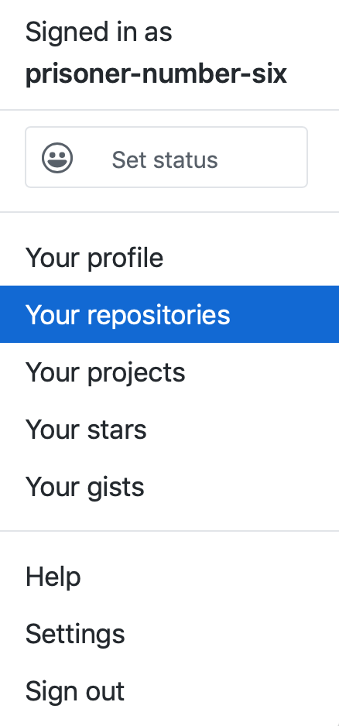
Go to your repositories
1
2

Slide 11
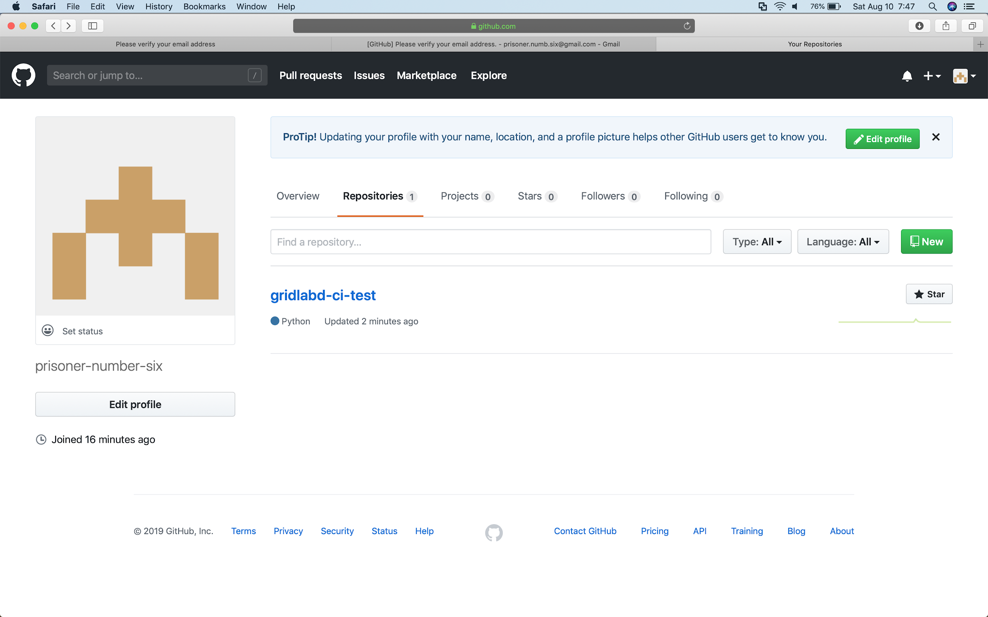
Open the new repository
1

Slide 12
Run Your GridLAB-D Simulation

Slide 13
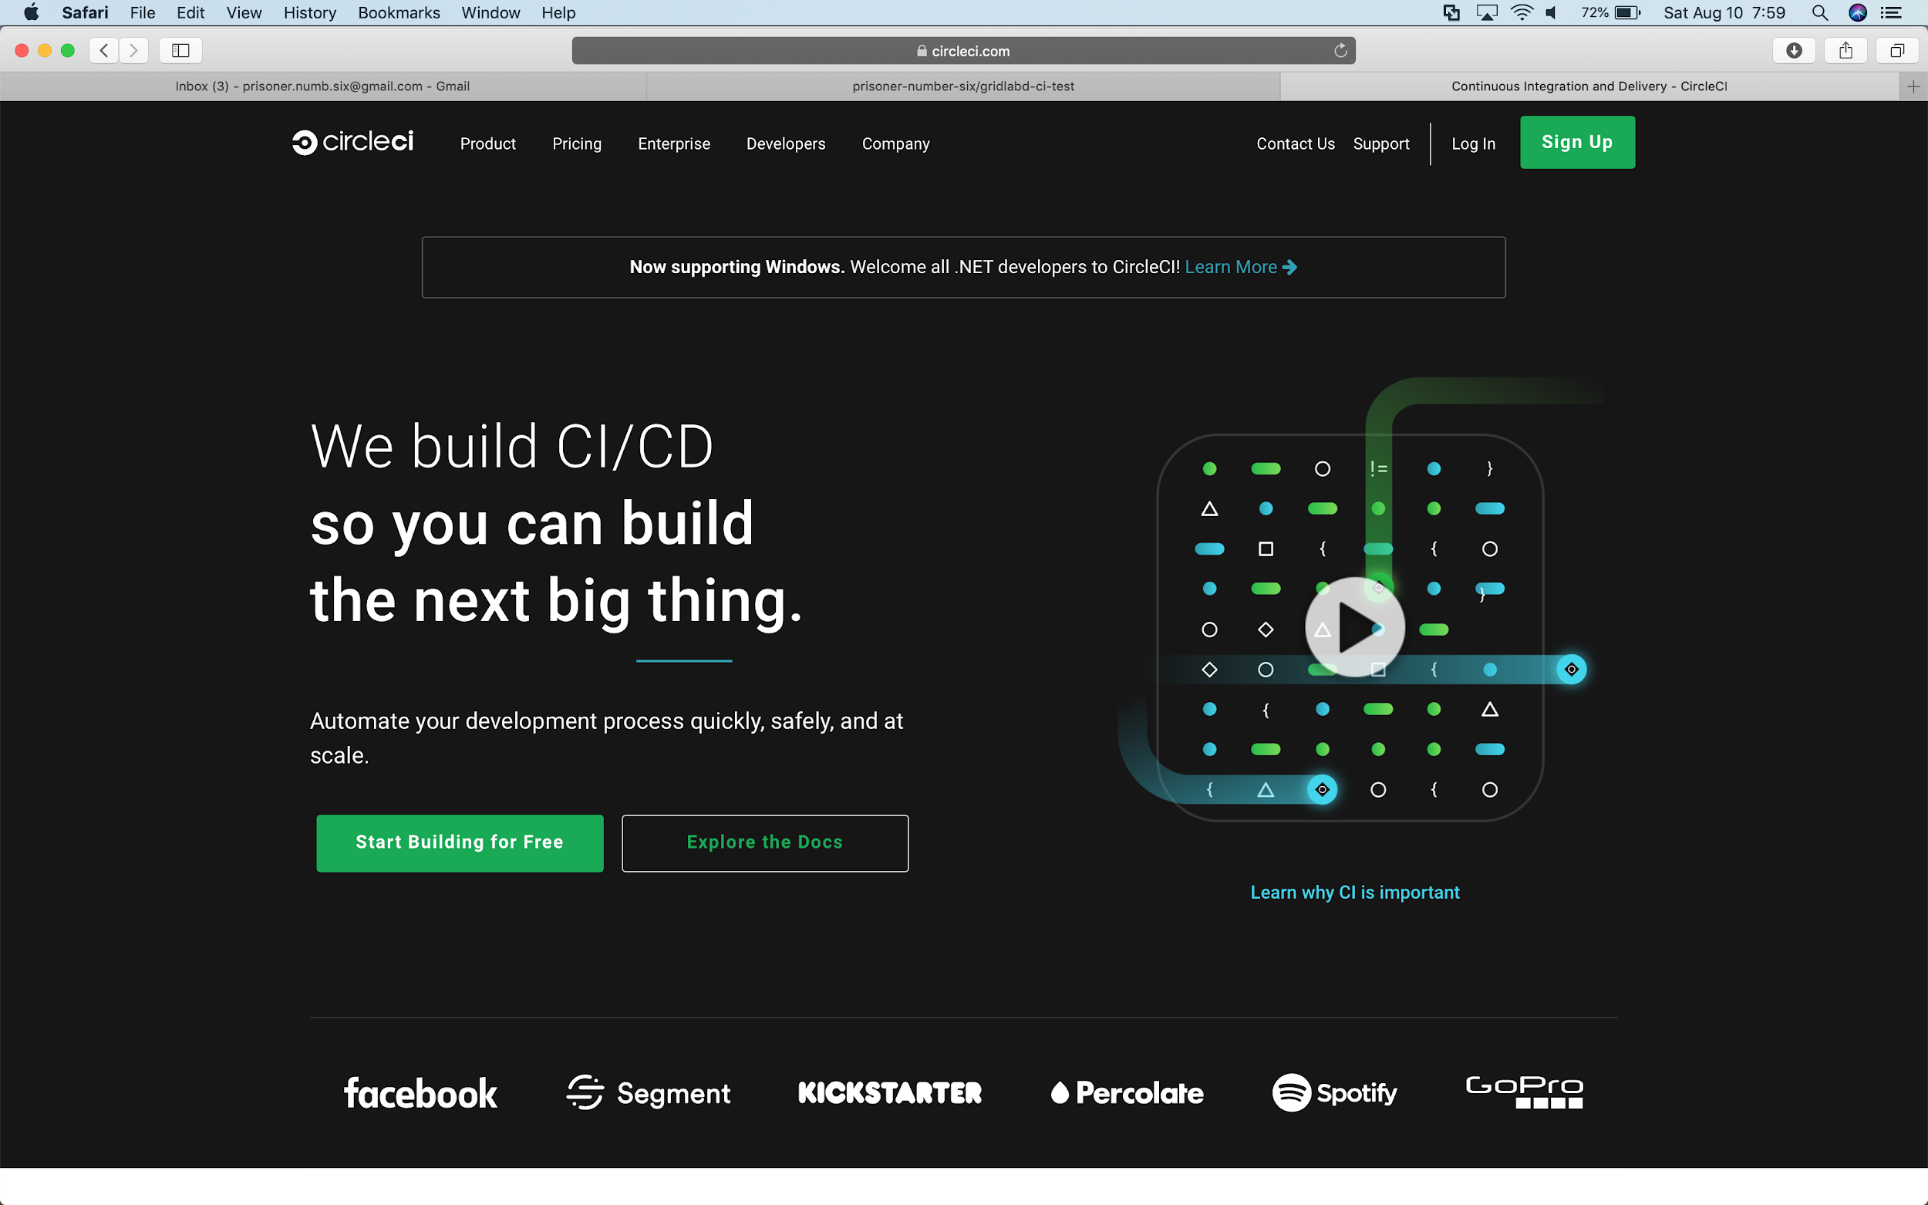
Open the CircleCI home page
1

Slide 14
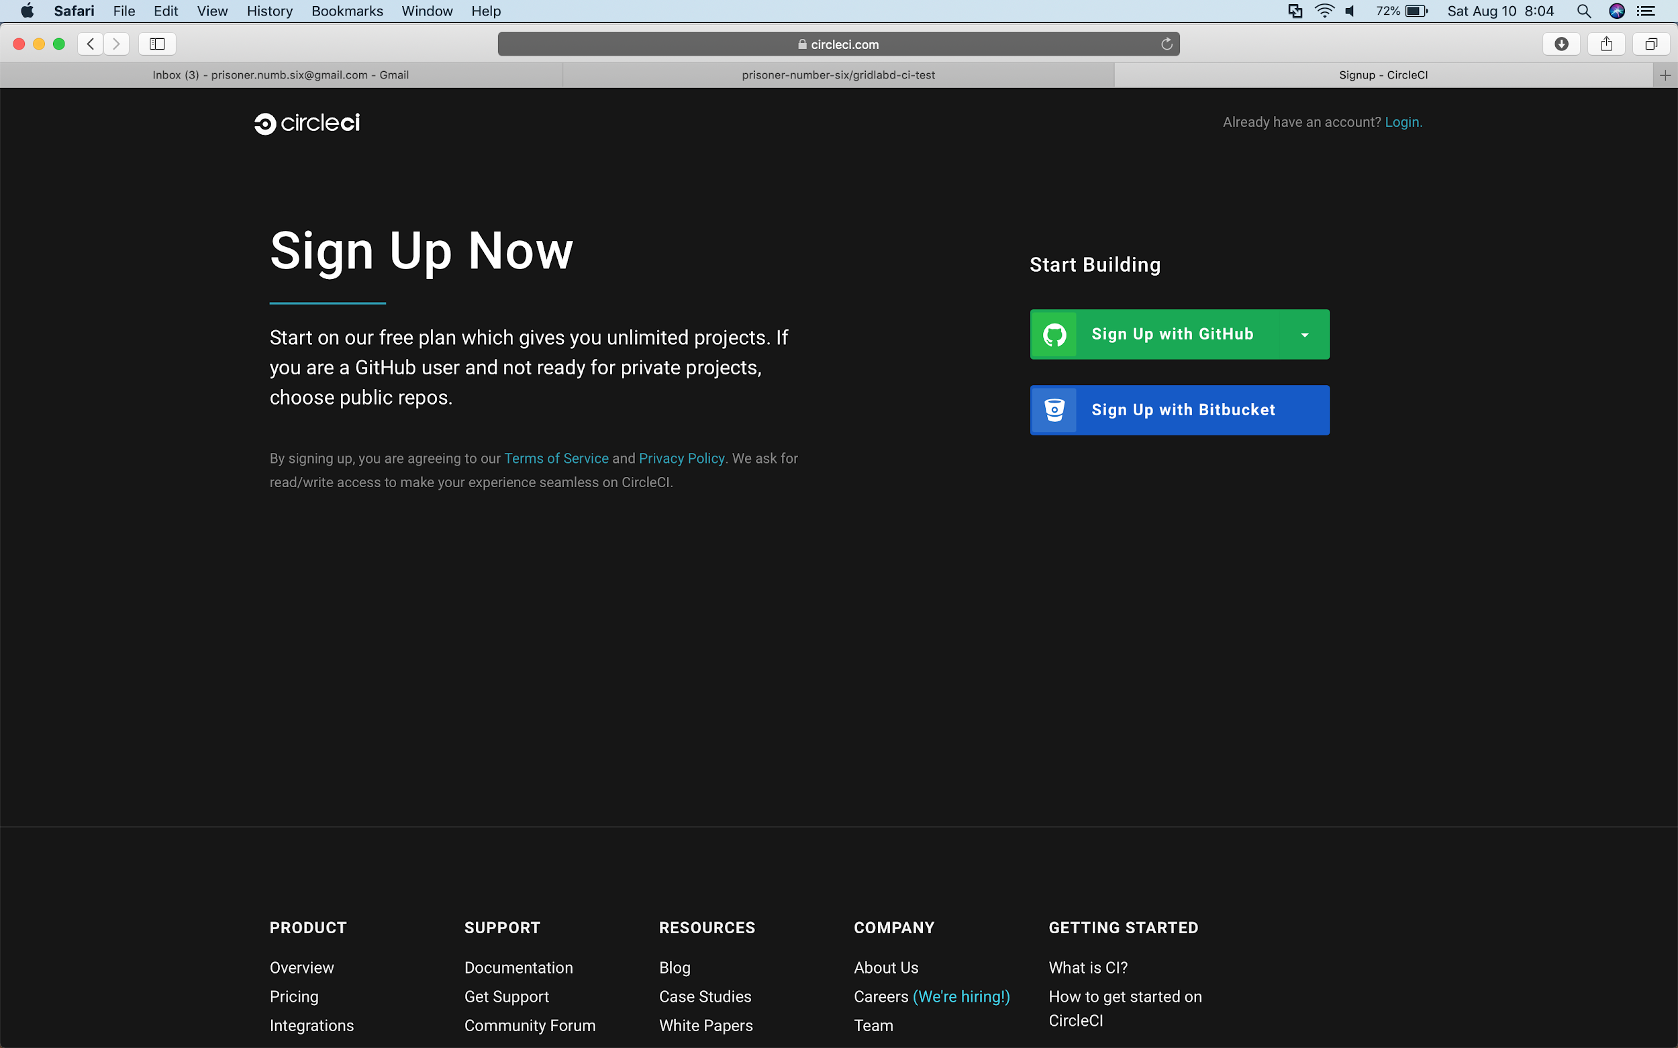
Signup using your GitHub account
1

Slide 15
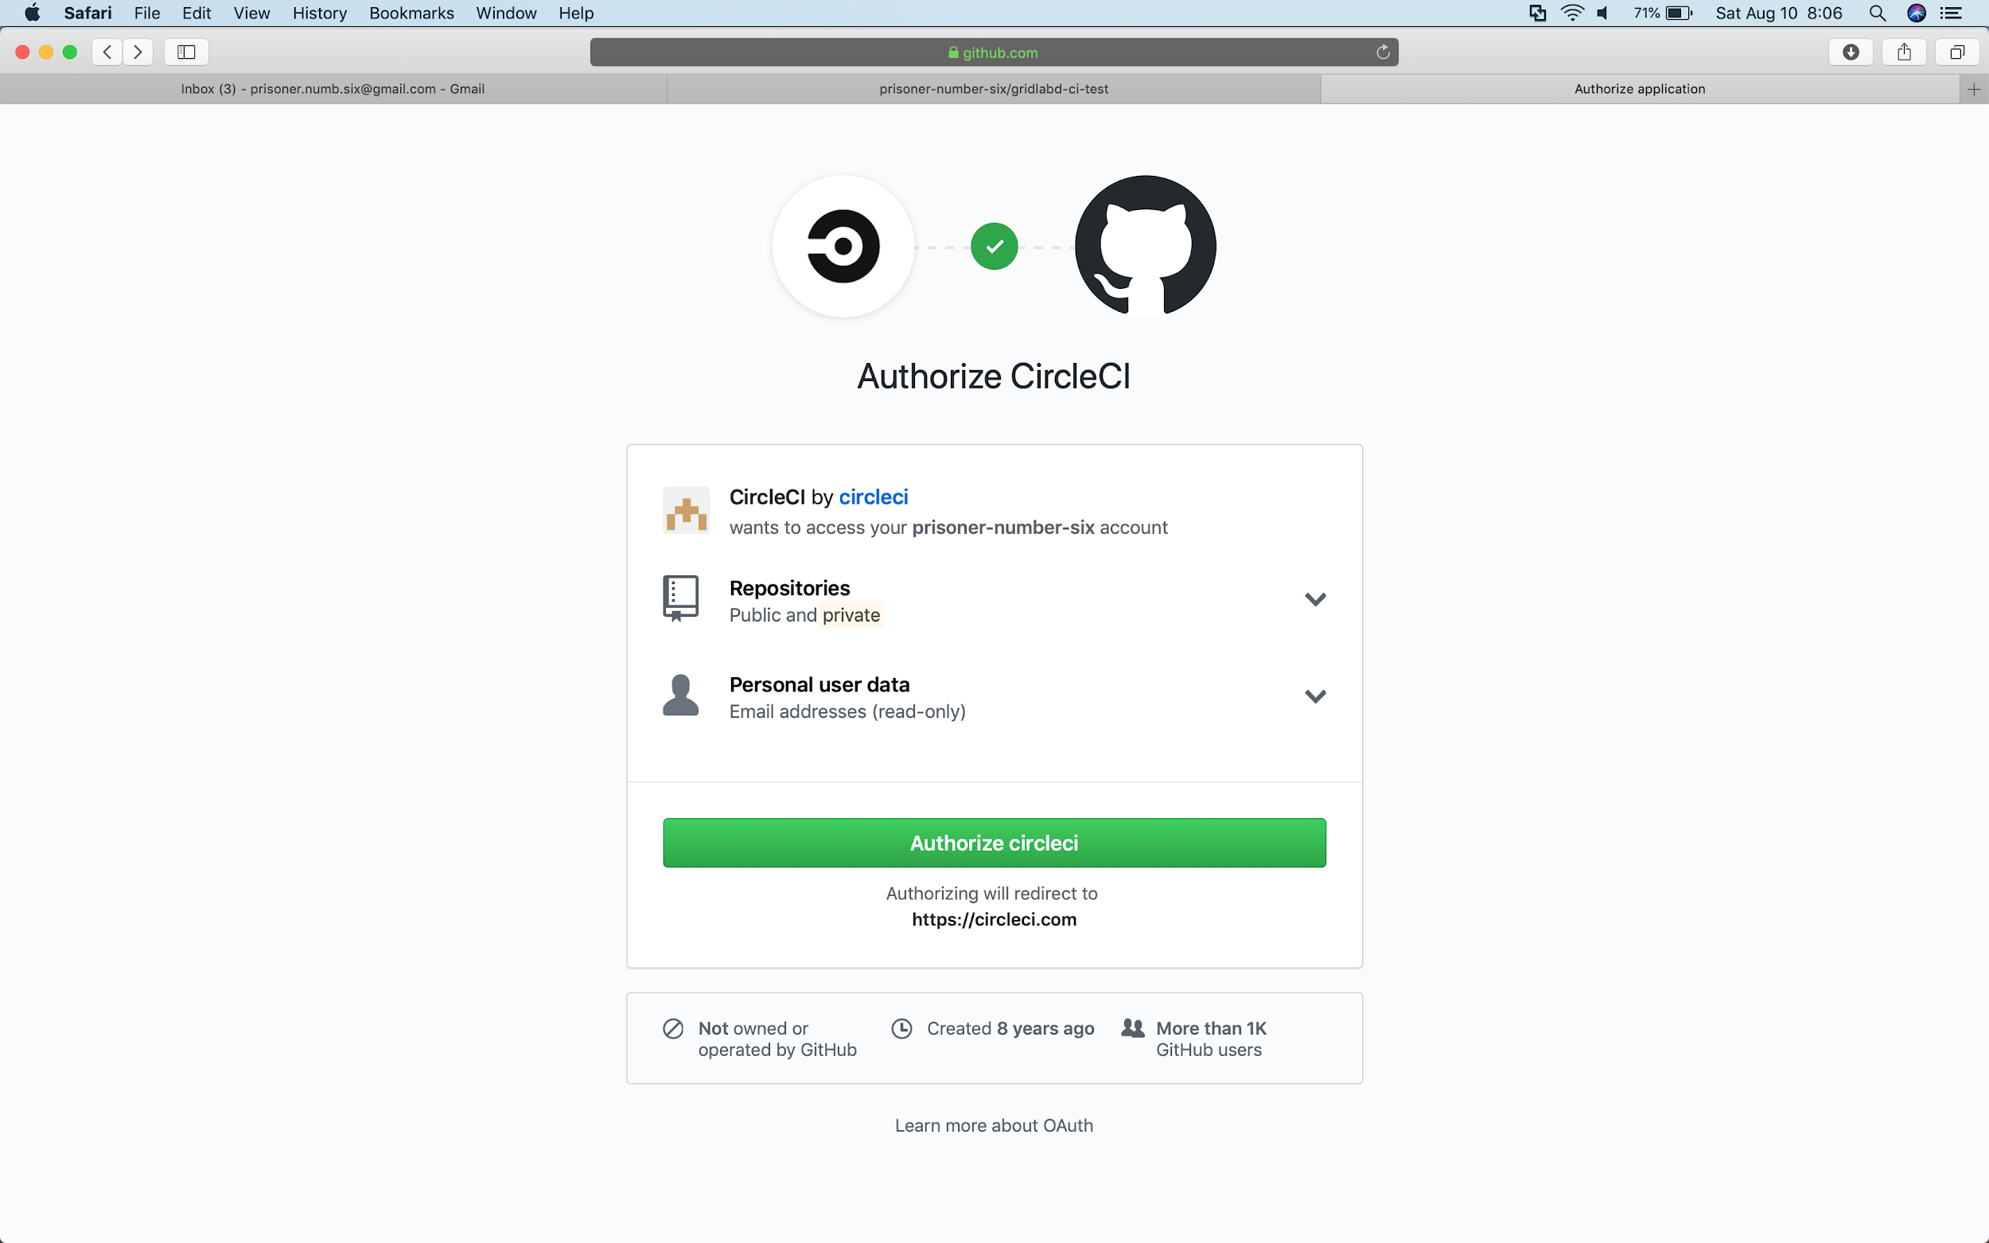
Authorize CircleCI to access your GitHub account
1

Slide 16
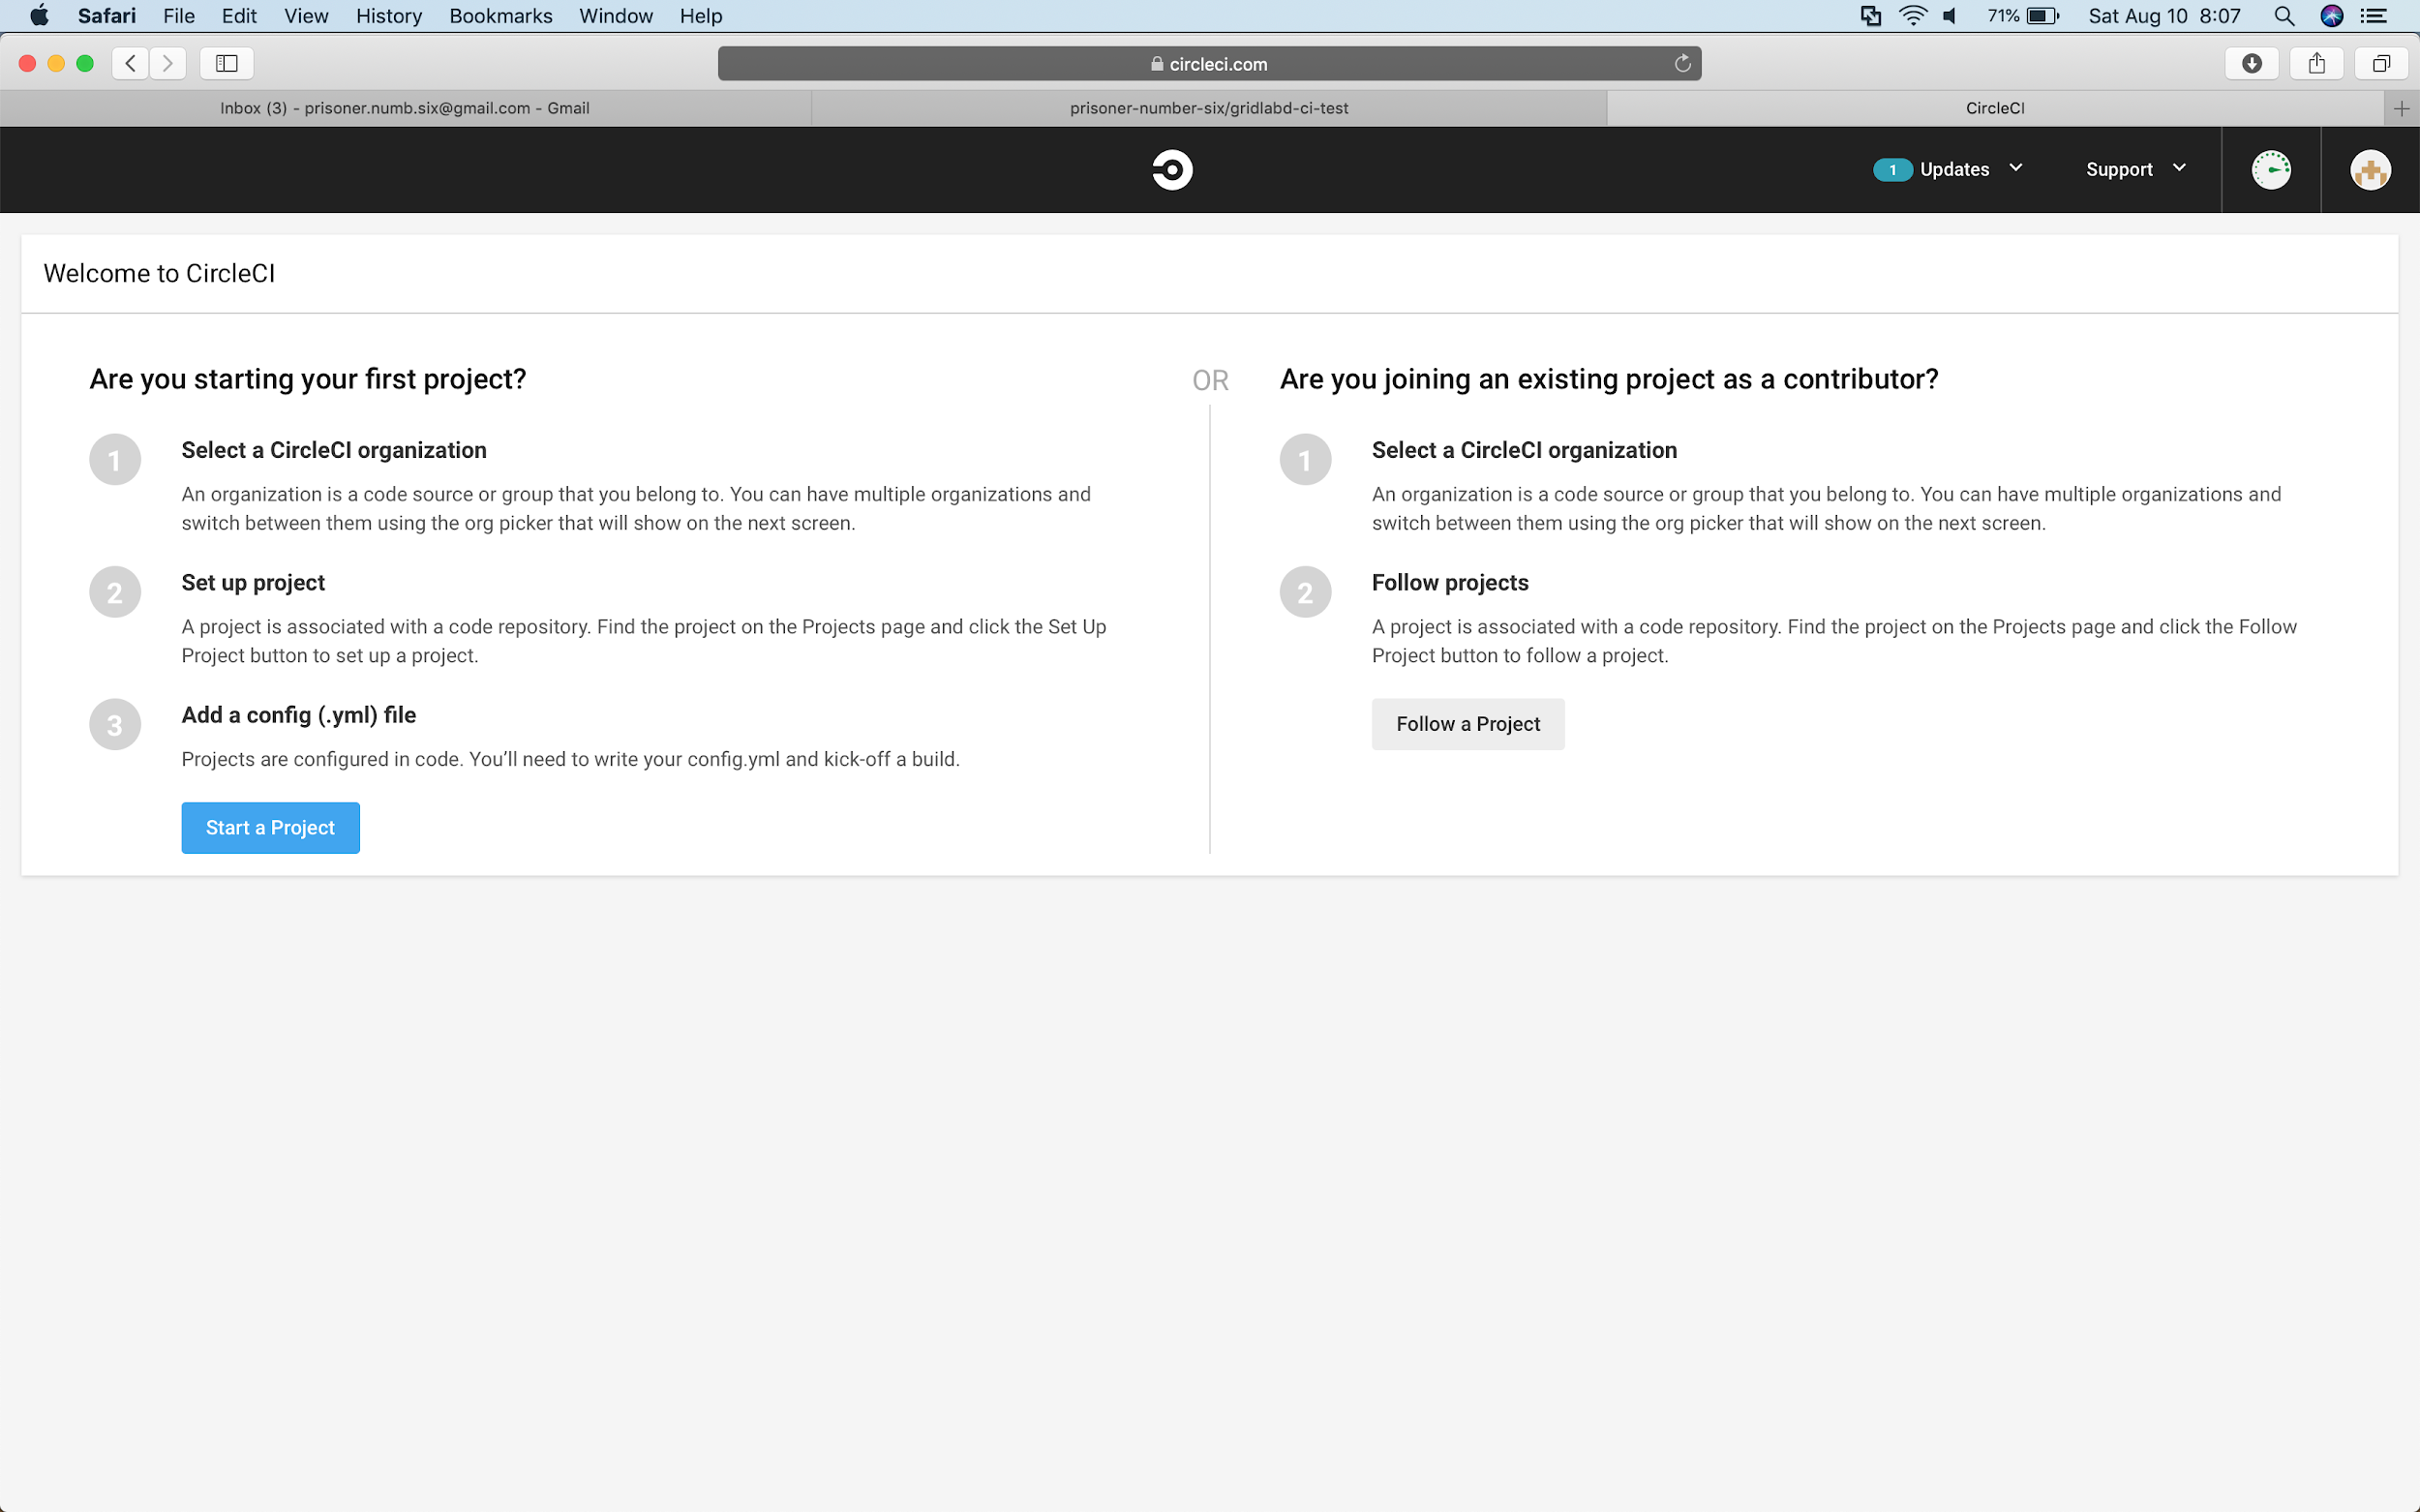
Follow your new project
1

Slide 17
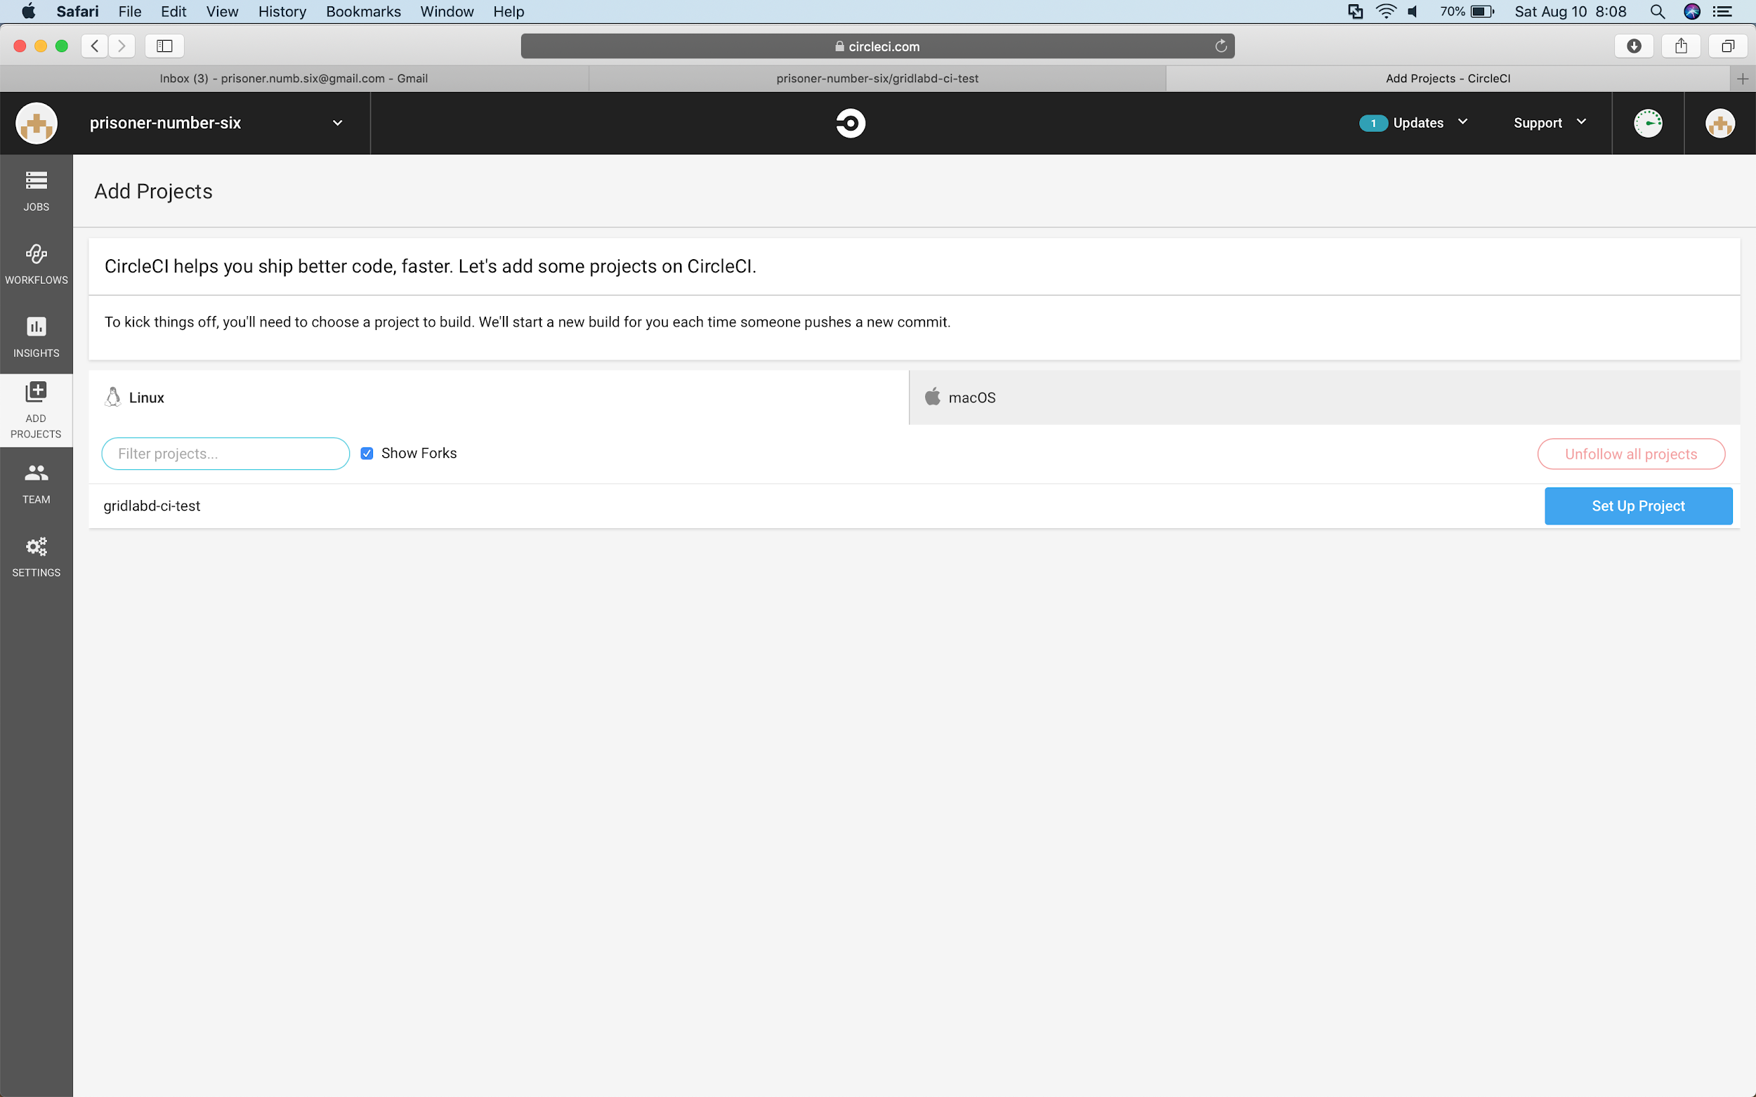
Choose the project to setup
1

Slide 18
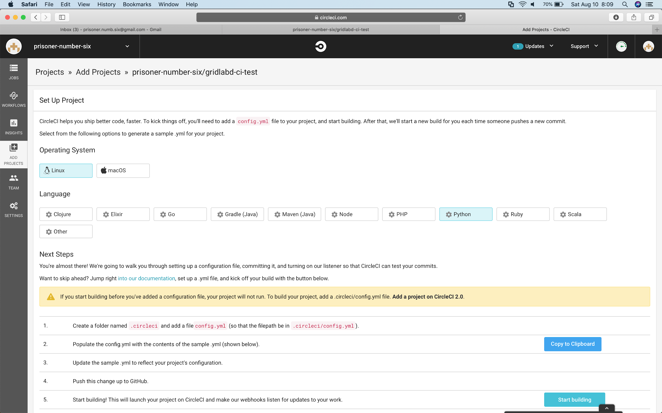
Start your project
1

Slide 19
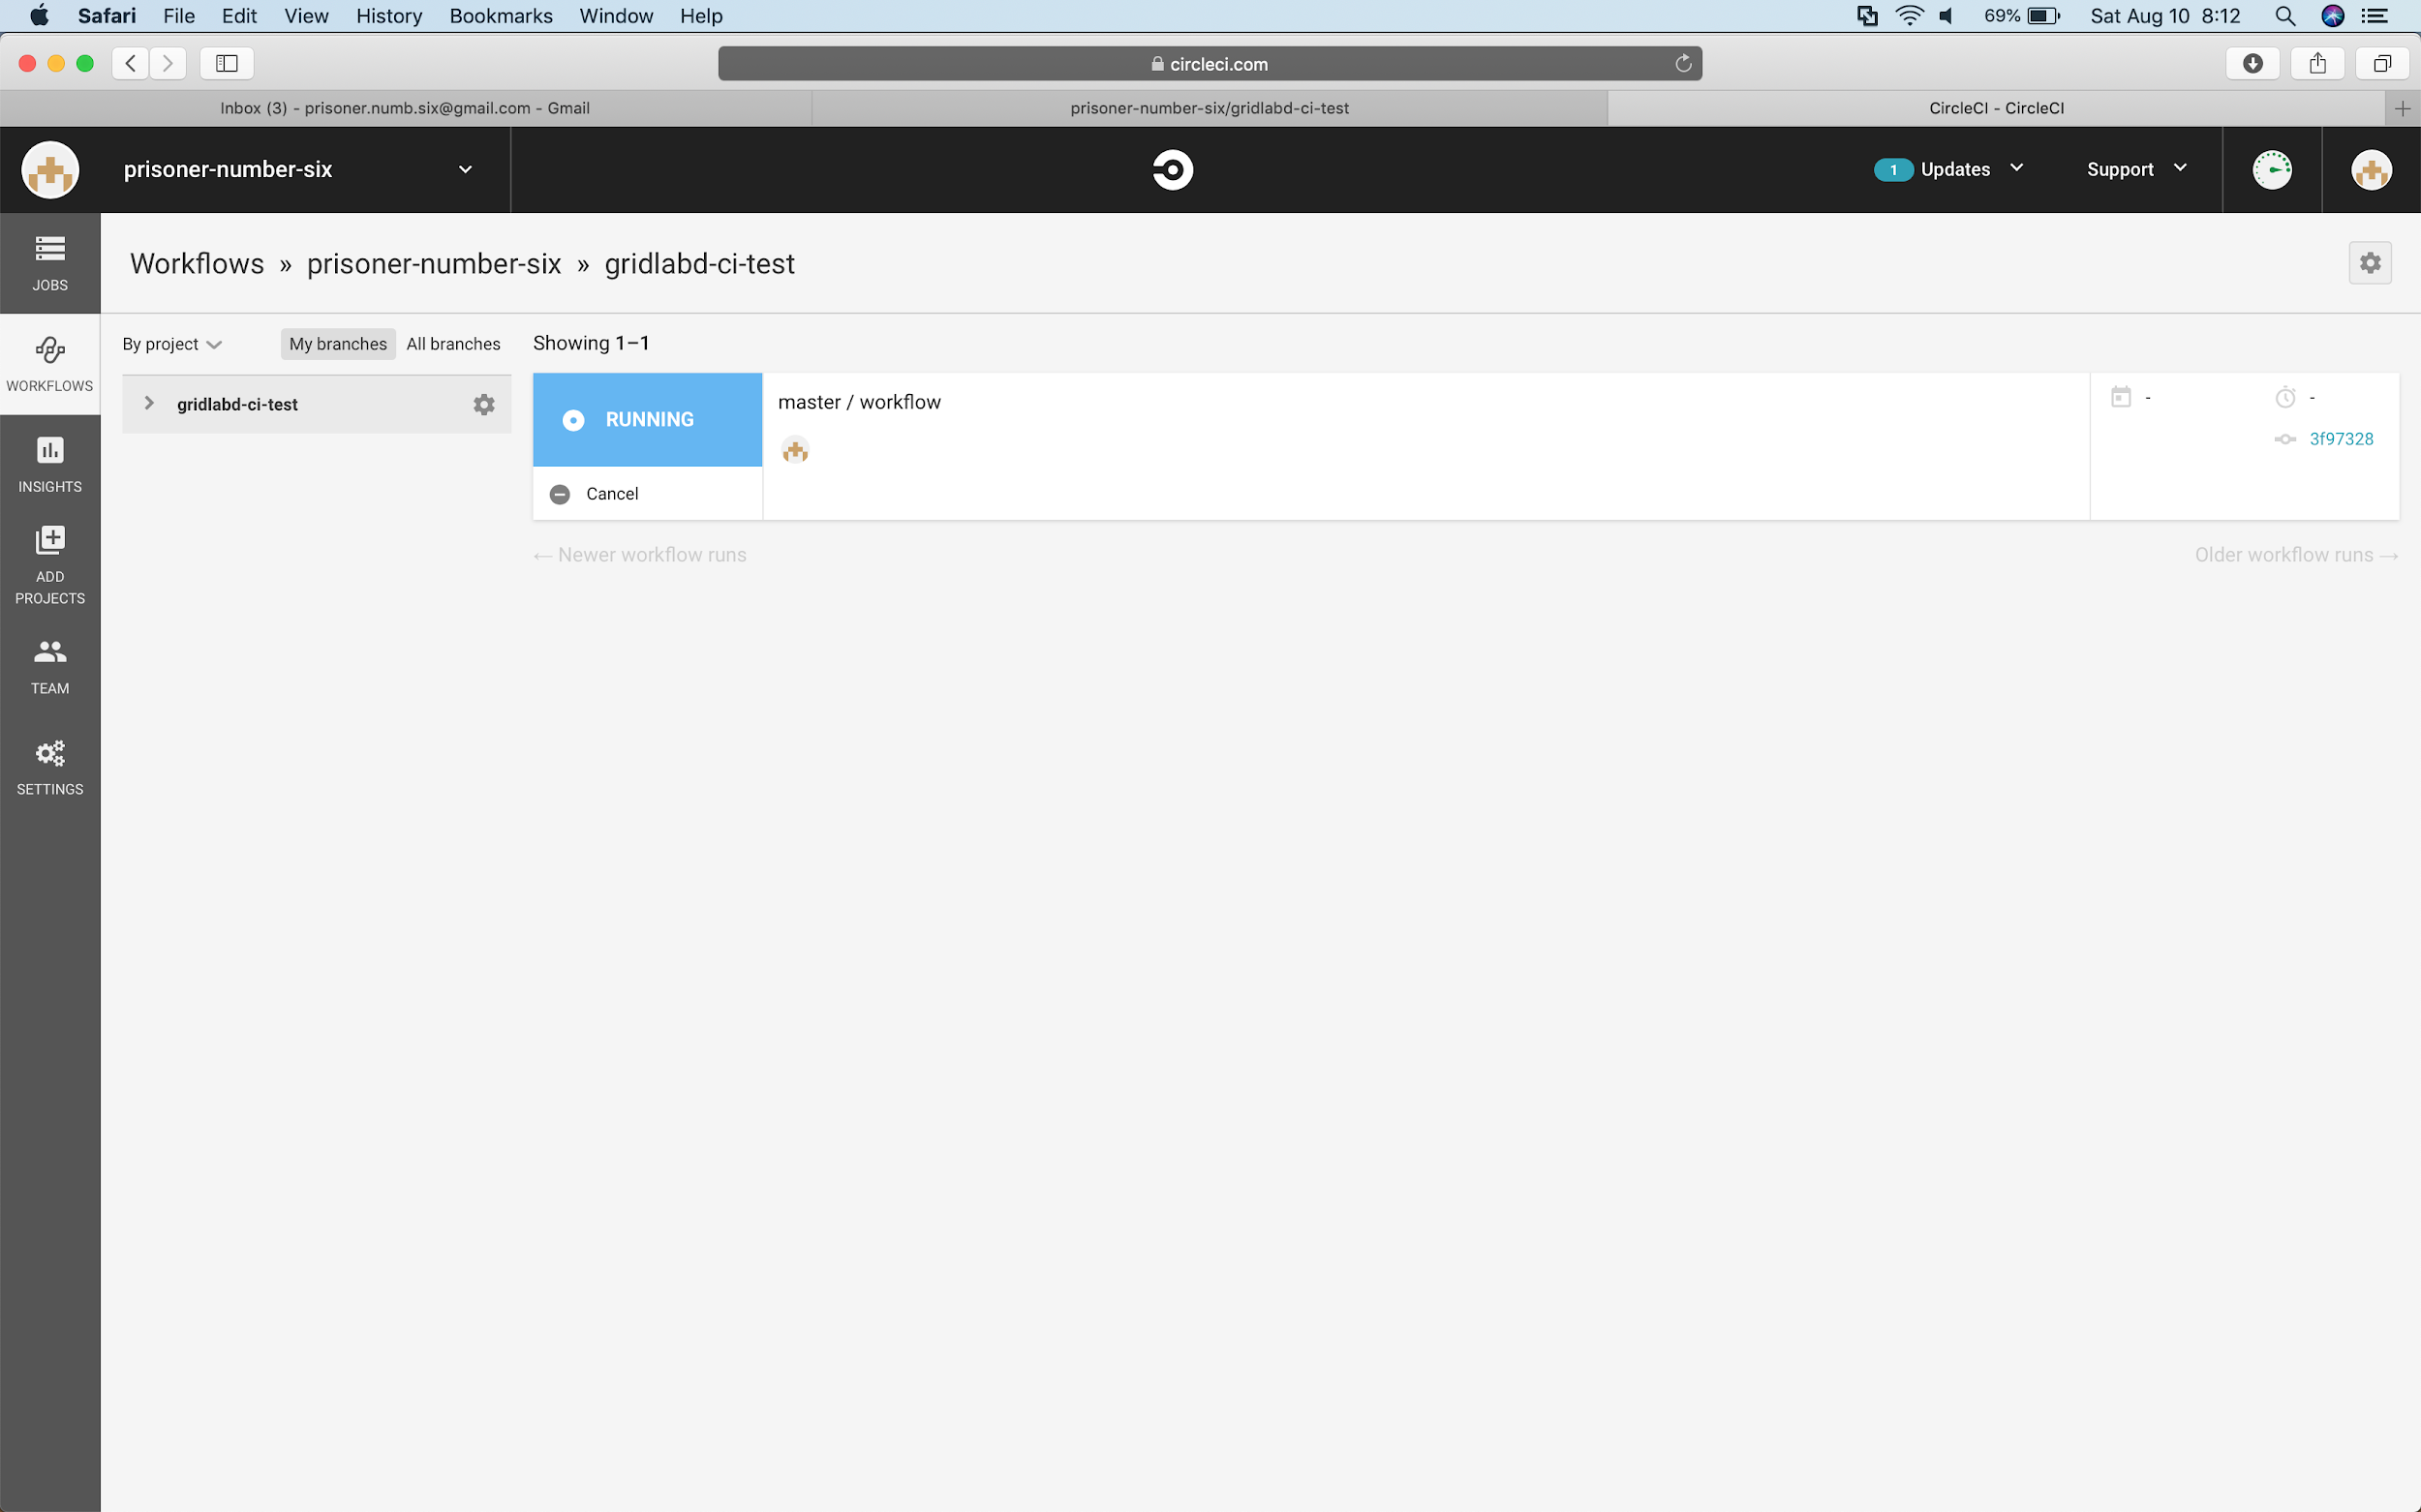
Watch the build
1

Slide 20
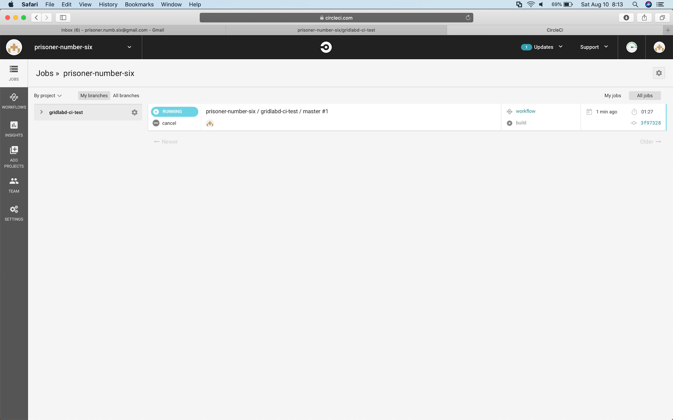
Monitor the progress

Slide 21
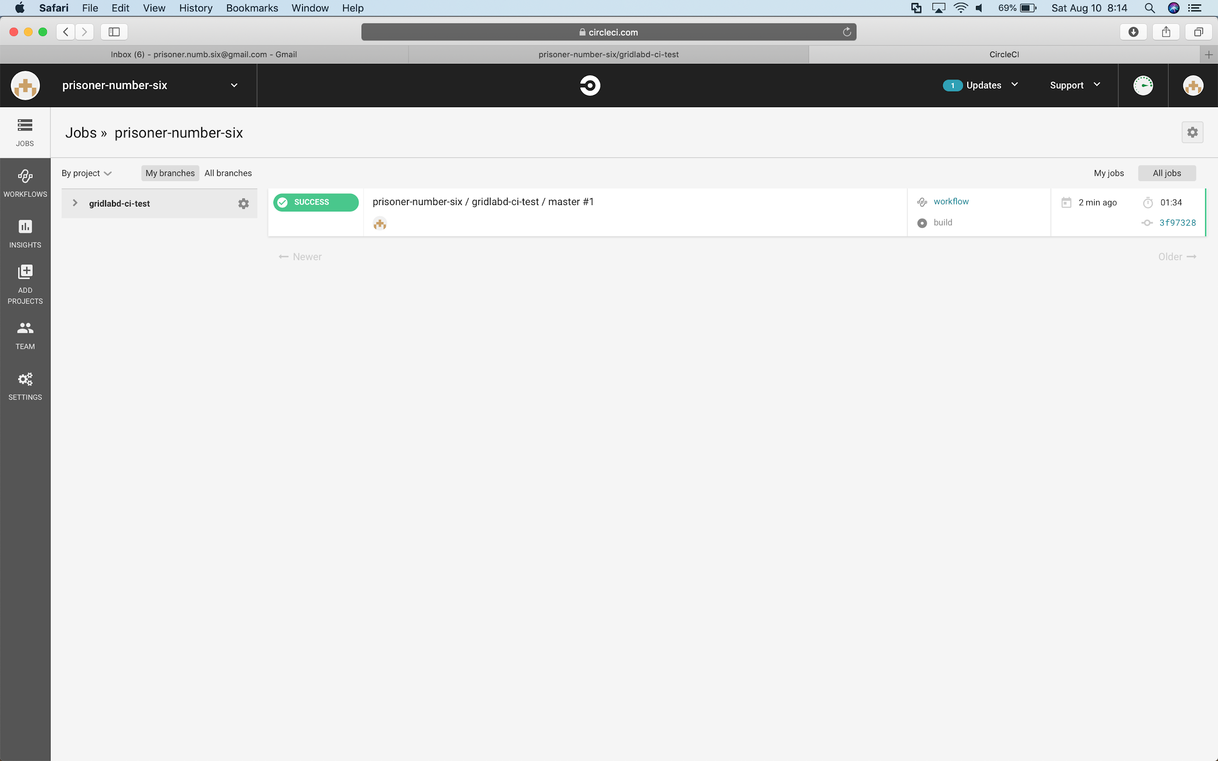
Look at the results
1

Slide 22
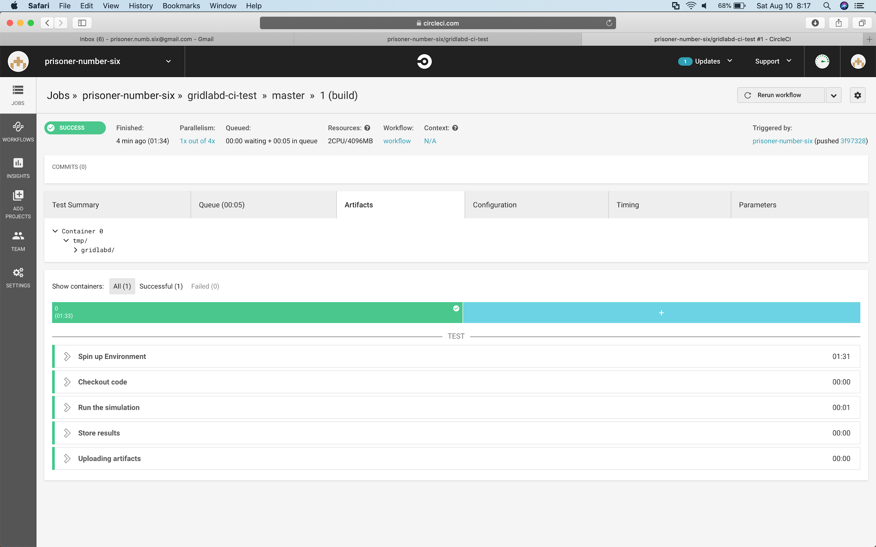
Look at the processing artifacts
1
2

Slide 23
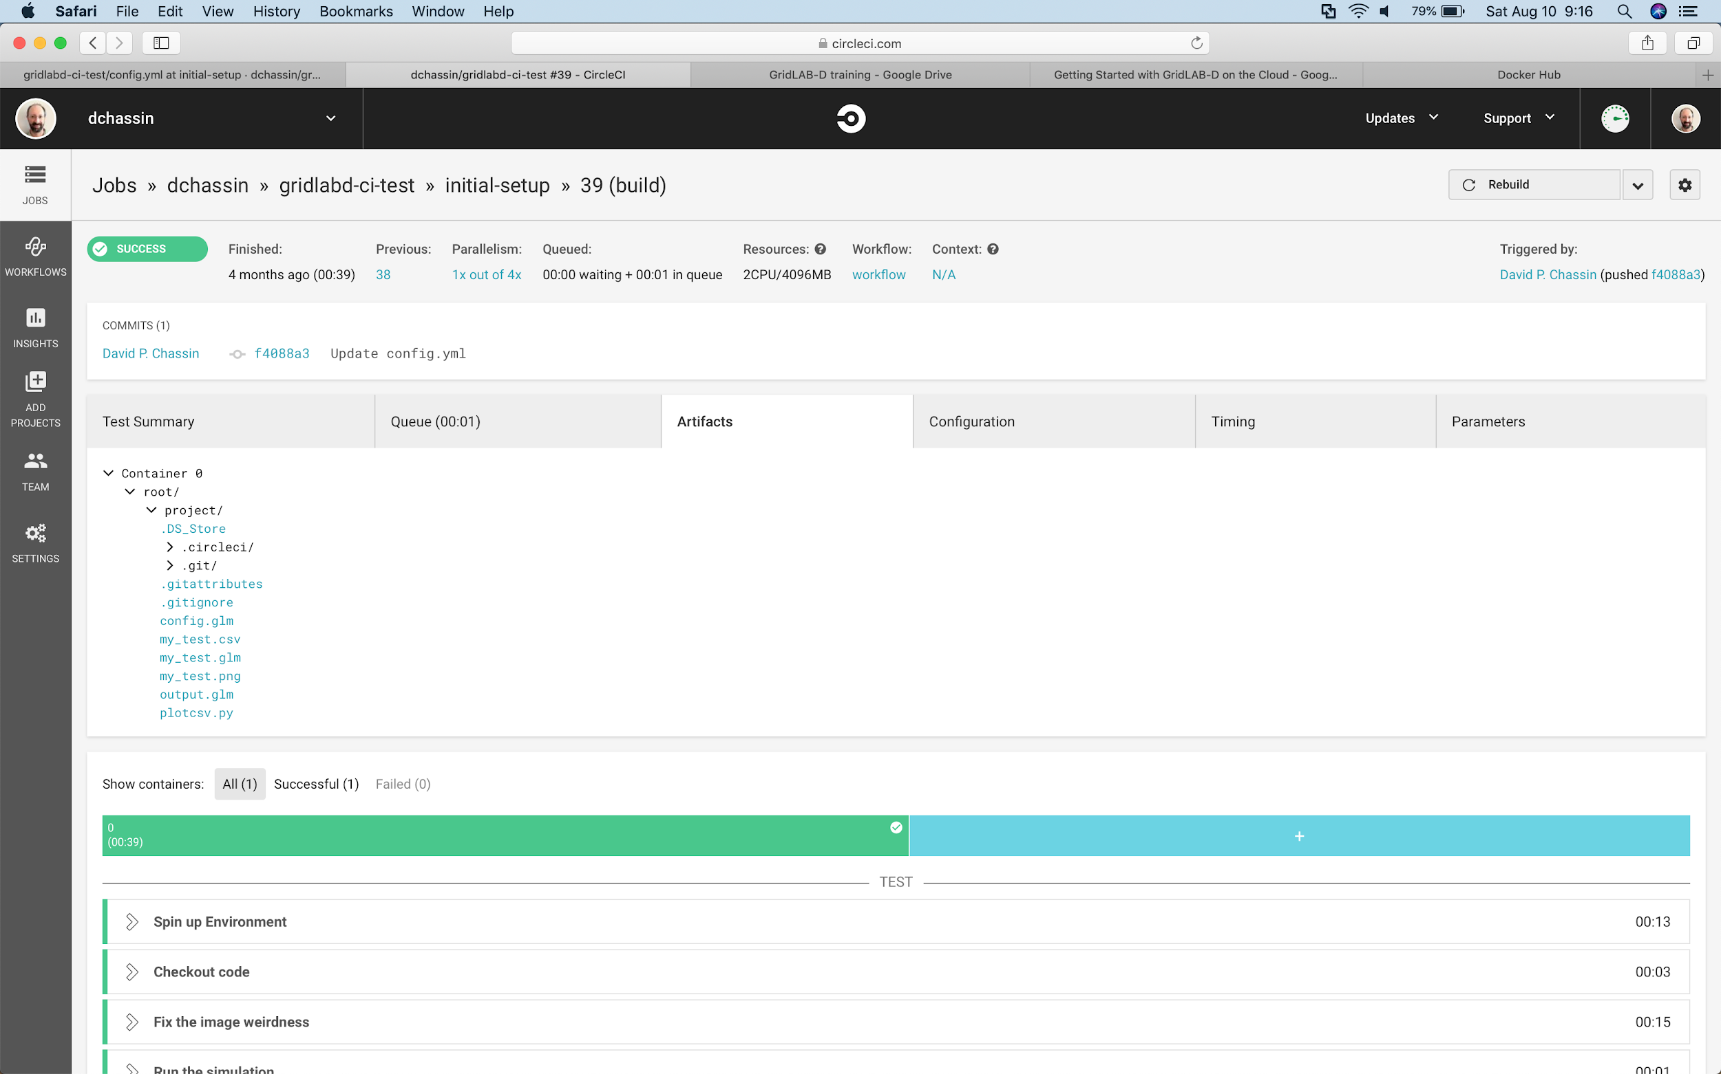
Open the output plot
1

Slide 24
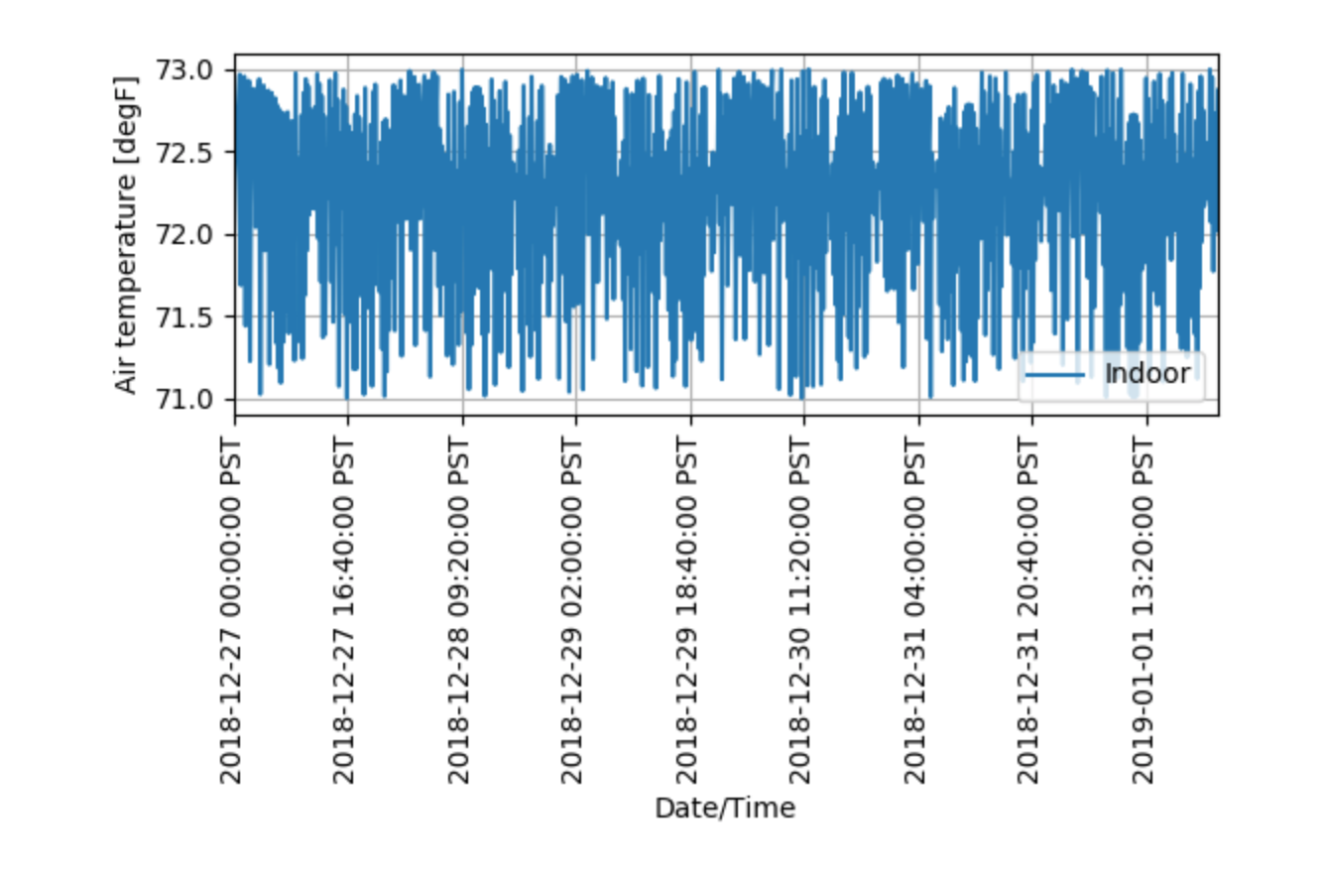

Slide 25
Modify Your GridLAB-D Model

Slide 26
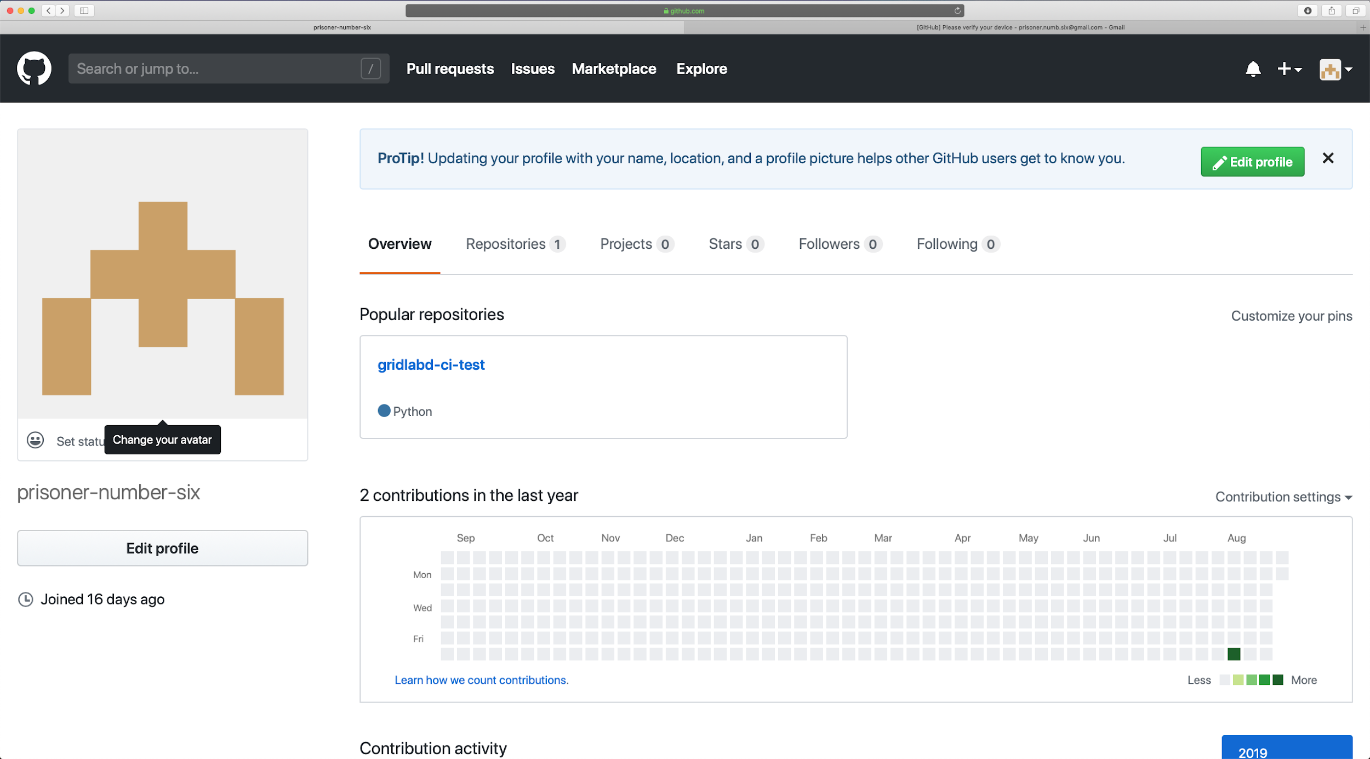
1

Slide 27
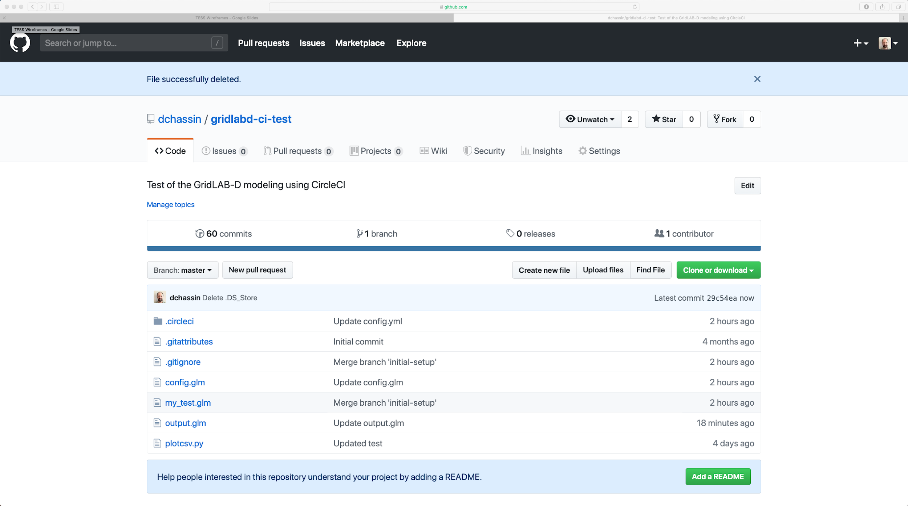
1

Slide 28
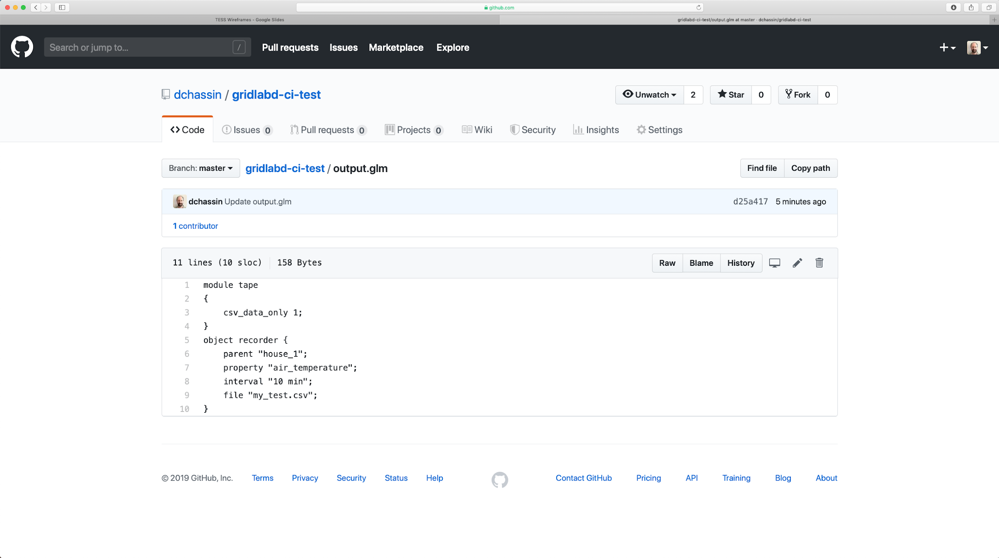
1

Slide 29
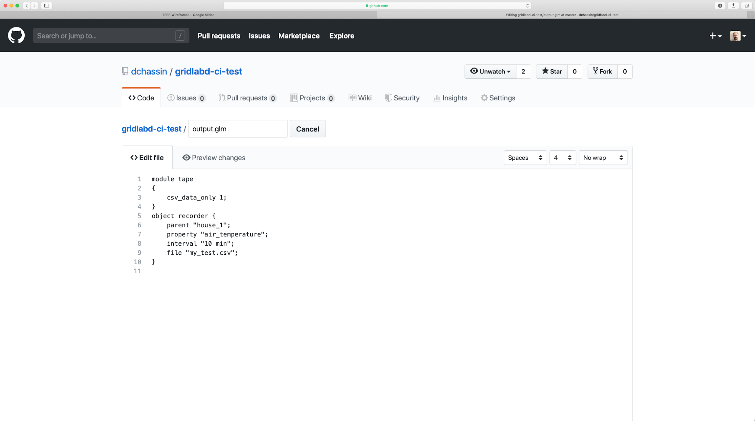
1
2

Slide 30
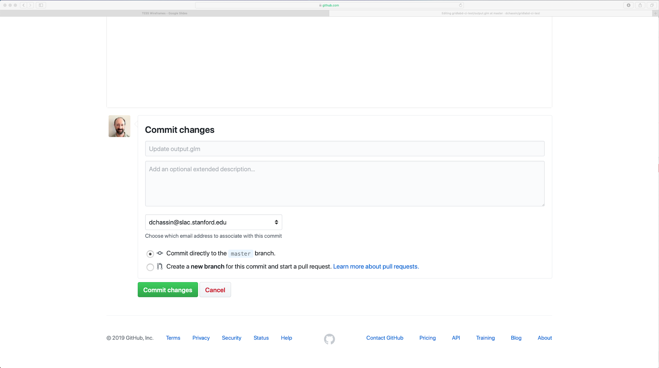
1

Slide 31
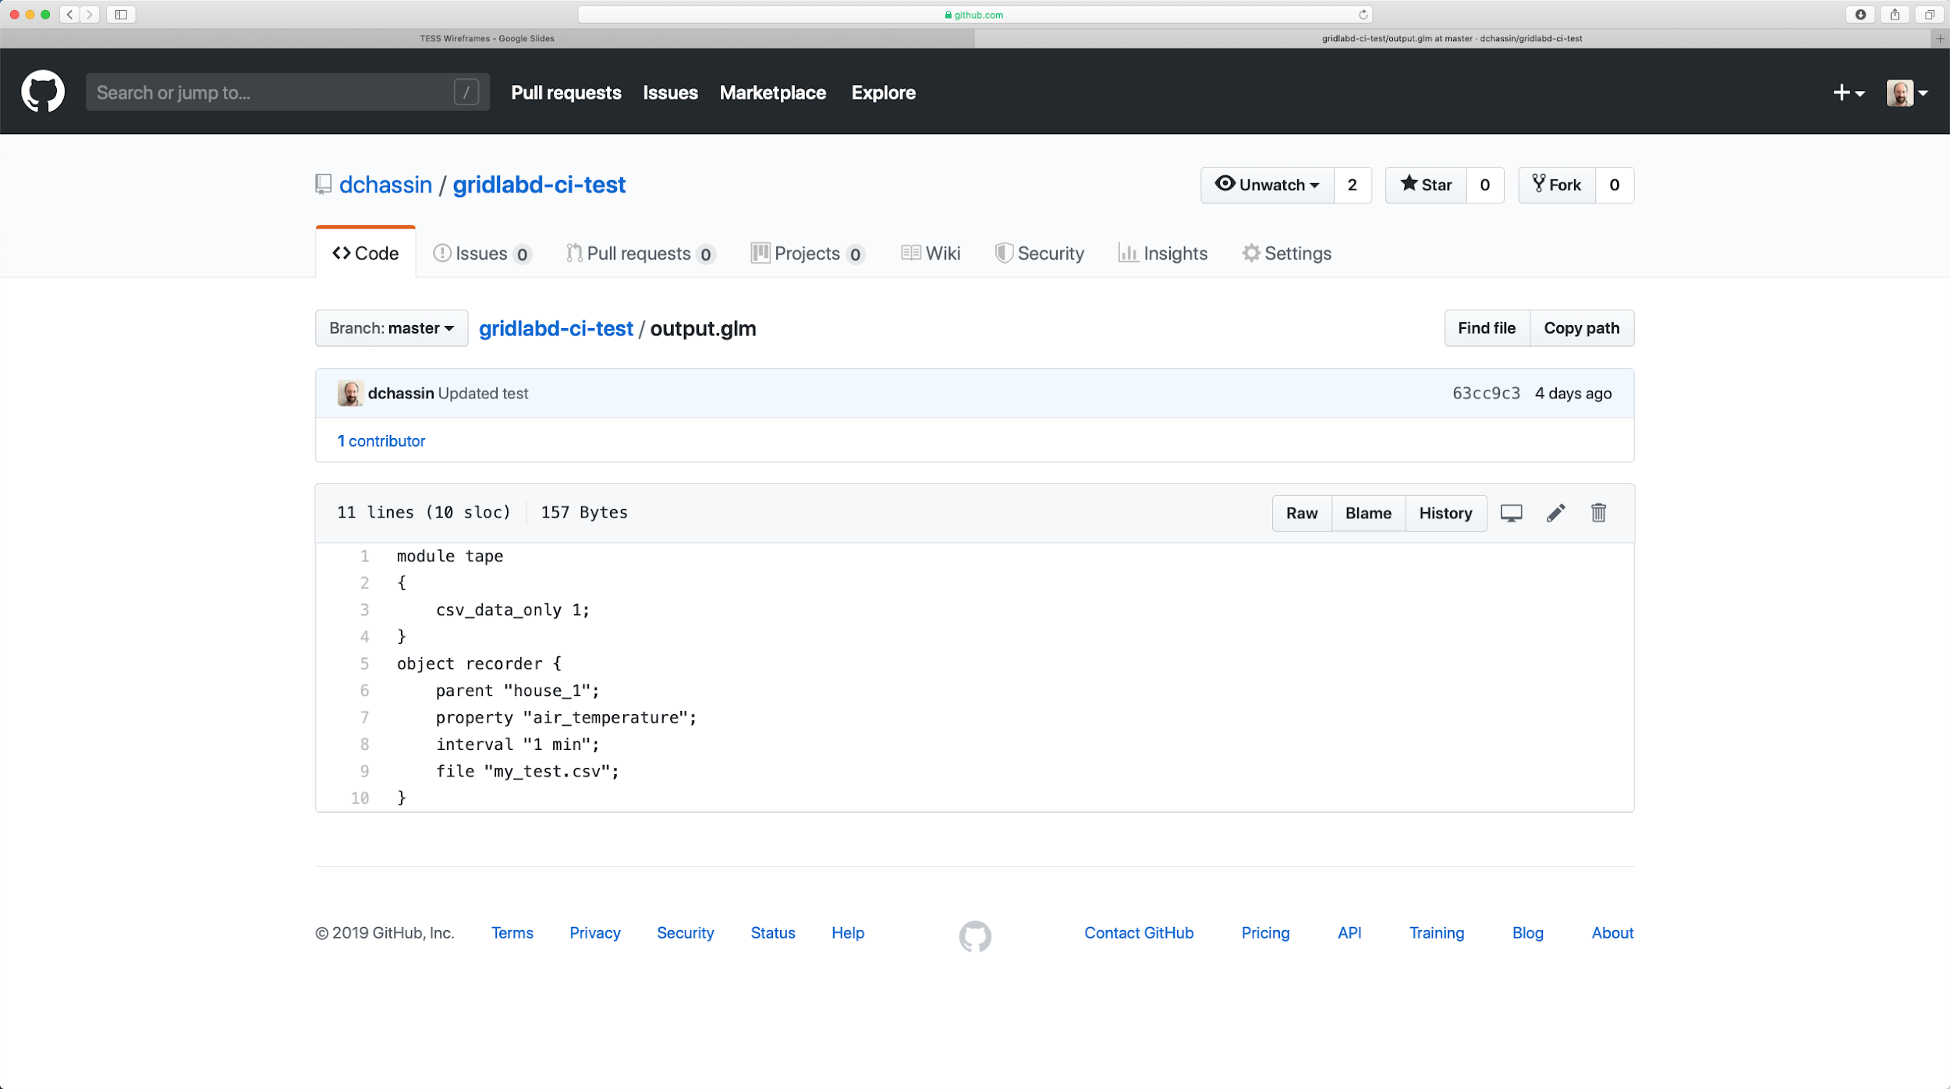

Slide 32
1

Slide 33
