Slide 1
Building Decarbonization in Context: Local Distribution Grid Infrastructure Decoding Grid Integrated Buildings November 12, 2019
Paul De Martini
Managing Partner, Newport Consulting
Visiting Scholar, Caltech

Slide 2
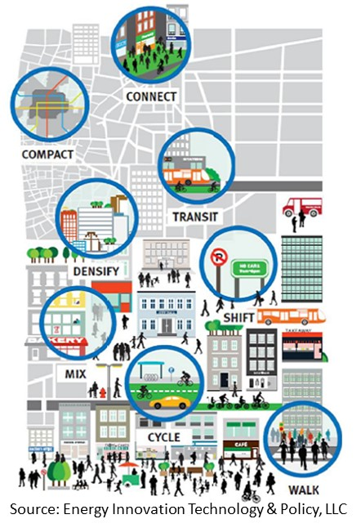
Distribution Grid as a Platform for Connected Communities
Building & Transportation Electrification + DER + Grid Platform Enable Connected Communities
Societal value from the creation of Connected Communities accrues in significant part based on the efficient use of clean, resilient electricity to create sustainable communities
Connected communities in California will be supplied increasingly in large part by distributed resources (perhaps 40% or more by 2040)
Connected communities will need to be resilient – this will depend in part on microgrids and other customer resources that need to be linked
Connected communities cannot be developed without a node-friendly distribution network that is open, visible, flexible, reliable, resilient and safe*
*More Than Smart principle adopted by CPUC

Slide 3
Distribution Grid as a Network Platform
Electric Distribution Network Value Can Be Super Linear
Metcalfe’s Law: Value of a network grows at the square of the number of connections – not applicable to electric grids
Geoffrey West: With each increase in size, cities get a super-linear value-add of 15% in increased efficiency and productivity.
De Martini-ICF: Increases in DER, electrified buildings and EVs (number of grid connections) create super-linear societal value - findings consistent with West’s “Scale” research
Distribution Network Value
Accumulated Network Value
Societal Value
Traditional Linear Value based on Electric Sales
Connections

Slide 4
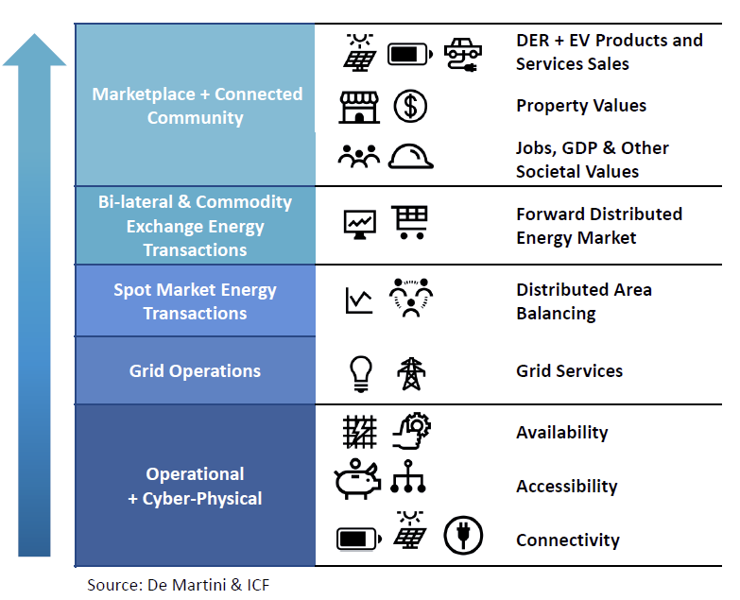
Distribution Network Value Potential
Realizing the value potential requires a different mental model
The cyber-physical grid infrastructure can provide the foundation for network value creation
Total value increases through the interdependent capabilities of each value layer
Higher electrification and DER adoption drives value
Capturing benefits requires a broader view of the solution set and deliberate alternative grid designs & investment to support value realization

Slide 5
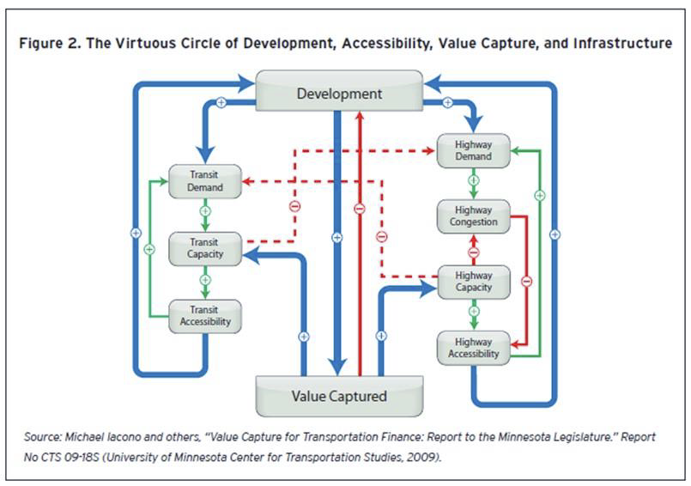
Transportation Network Characteristics
Adapting Transportation Concepts for Electrified Connected Communities
Connectivity: Connectivity refers to the density of connections in path or road networks, capacity and directness of links.
Accessibility: Accessibility refers to market access measured through statistical indicators of effective market size or effective market density and ease of access.
Availability: Availability refers to a transportation system's performance to deliver services when demanded.

Slide 6
Distribution Network Criteria
California’s highly distributed electric system will need to address these criteria

Slide 7
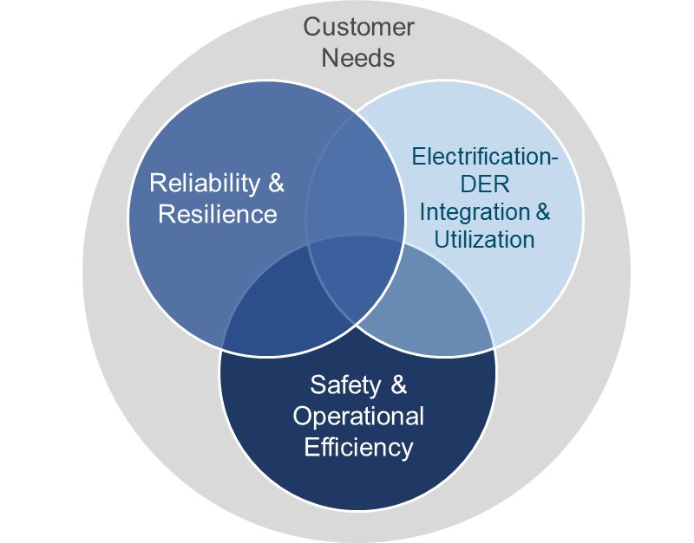
Distribution Grid Planning Needs to Converge
Process Changes: Discrete distribution planning activities need to be converged into an integrated plan:
Resilience Planning
Asset Management (aging infrastructure replacement)
DER based Planning (DRP)
Grid Modernization
Structural changes in distribution grid designs are required – grid we have is not the grid we need*
Resilient, 2-way networks are essential – CA’s distribution grids need to become generation ties & transactive networks to meet our goals
Standard engineering design practices need to evolve
Requires optimized infrastructure investment
NWAs help optimize capital investment, but do not replace the need for distribution infrastructure investment to create the platform needed
Multi-faceted Distribution Planning Criteria
* Source: Hawaiian Electric

Slide 8
Thank you
https://newportcg.com
https://resnick.caltech.edu

